Slide 1
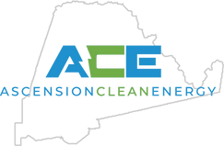

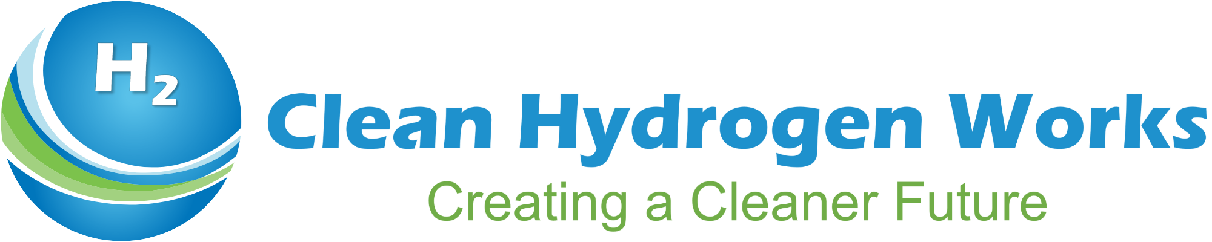


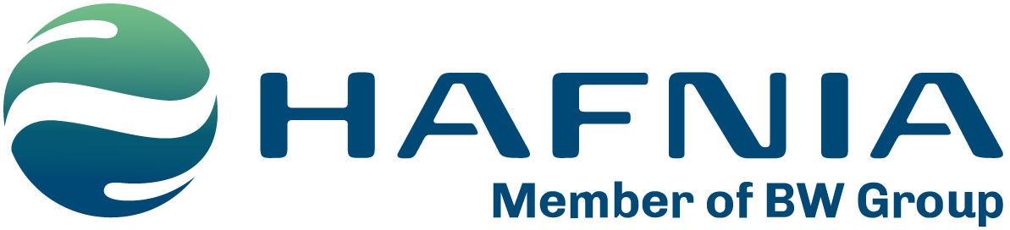
Ascension Clean Energy (ACE)
Presentation to Louisiana’s Clean energy Task force
Vee Godley, SVP Project Development
Dec. 3, 2024

Slide 2


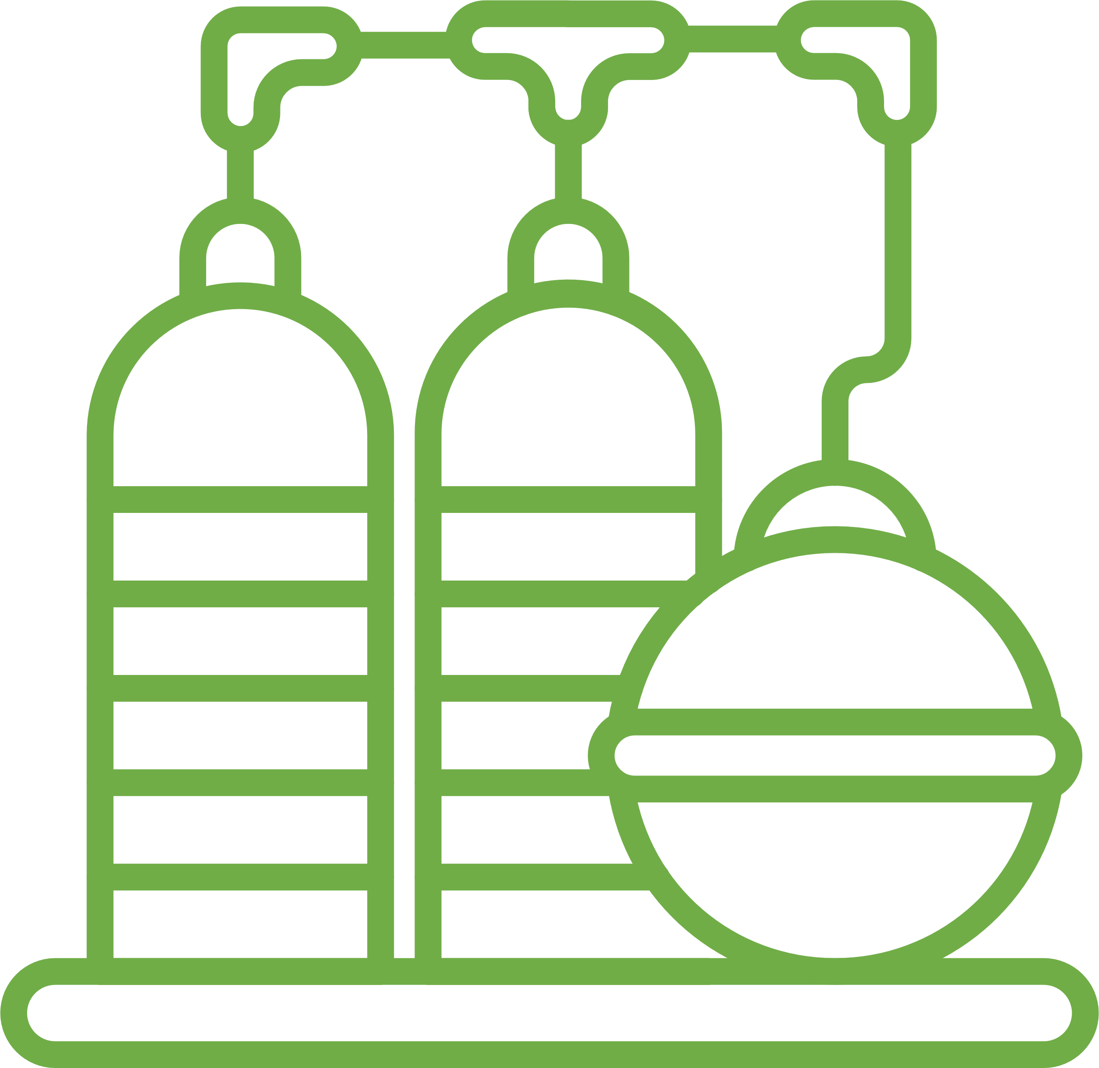
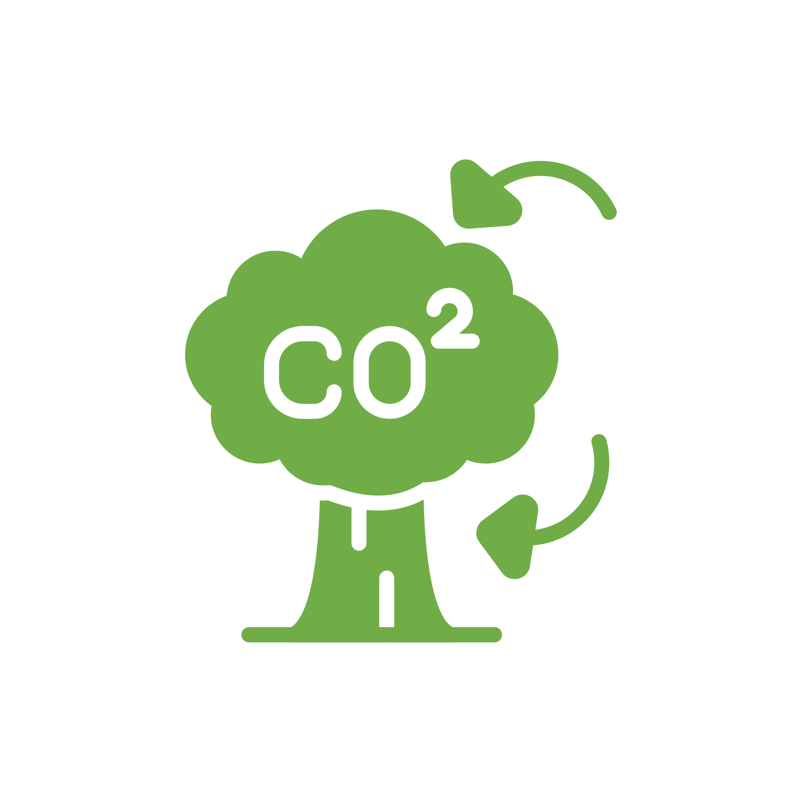

About Ascension Clean Energy (ACE)
ACE is a world-scale clean hydrogen-ammonia manufacturing facility proposed for a 1,700-acre site on Ascension Parish’s RiverPlex MegaPark near the Modeste community.
$7.5 billion
capital investment
350
new, permanent jobs
1,500
construction jobs
7.2 million
metric tons of annual
ammonia production
98%
CO₂ capture
2

Slide 3
State-of-the-Art Production Process
Air Separation Unit
Nitrogen
Nitrogen Wash Unit
N₂-H₂ Mix
Ammonia Synthesis Unit
Air
Oxygen
N₂-H₂ Mix
Low-carbon Ammonia
Topsoe Autothermal Reformer
Hydrogen
Power Generation Unit
FOB
low-carbon Ammonia
Natural Gas
~266,000 MMBtu/d
36.9 MMBtu/t.NH₃
Ammonia Tanks
Dock
Up to 98%
CO₂ captured
Facility-wide power
2.4 MTPA.NH₃
2.4 MTPA.NH₃ based on 8,000h/yr operating rate. Annual total volume upside possible with higher operating rates.
CO₂ Transport & Storage
ExxonMobil
FIRM
4.6 MTPA.CO₂
1.92 t.CO₂/t.NH₃

Slide 4
The Ace Advantage
Cost competitive
Low carbon intensity
“Infrastructure-first” approach
Experienced shareholders & partners
Commitment to project delivery
Commitment to the community

Slide 5







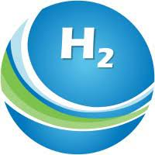

Advantage: Cost Competitive
ACE is positioned to be the most competitive blue producer
in the global market
Green
Blue
US Blue
Shipping
ACE
  Mega-module construction
Other blue hydrogen producers in order of lowest landed cost
  Existing CO₂ pipeline network
  Power self-generation eliminates grid import expenditure
0
10
20
30
40
50
60
70
80
90
100
110
120
130
140
150
160
170
Source: Data provided by independent major international consulting firm
MTPA NH₃

Slide 6
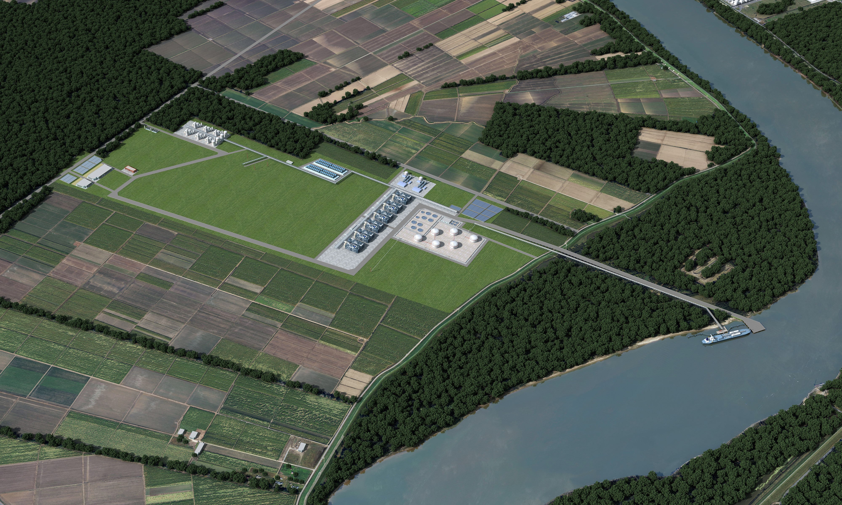
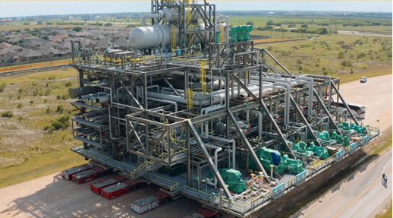
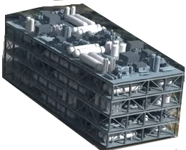
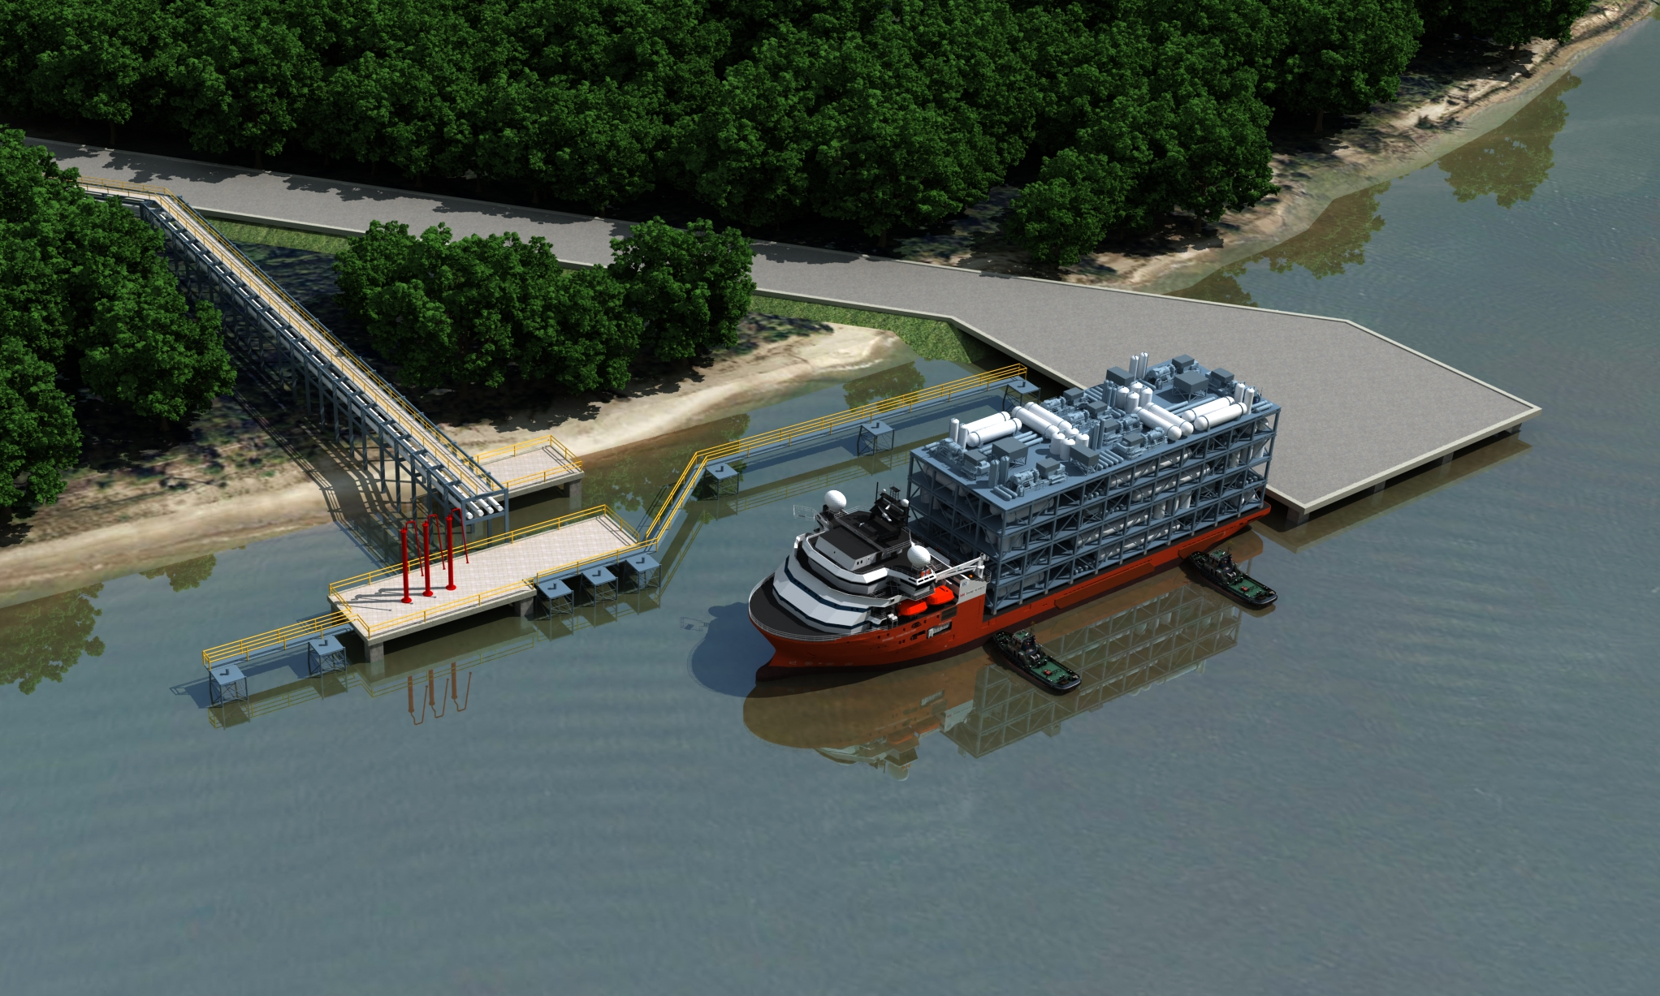
Advantage: Mega-Module Construction
Self Generated Power
Hydrogen-rich fuel
Zero Scope 2
= CI advantage
ASUs
Cooling water
Flares
Heavy Haul Road → Mega Module
Max 330’ long x 125’ wide x 125’ tall
up to 10,000 tonnes
Topsoe ATR Technology
Total 6 trains x 1.2 = 7.2 MTPA
First FID will comprise
2 trains = 2.4 MTPA
Ammonia tanks
Marine Facility
Module / Product ship flexibility
275m LOA x 48m x 50 ft
Mississippi River
ACE Intro Videos
Part 1: Project Overview (https://youtu.be/4TVmeC_7bXk) | Part 2: Project Differentiation (https://youtu.be/yqieHH2q2jE)
Heavy Module Image credit: Gulf Coast Growth Ventures (an Exxon-Sabic JV)

Slide 7



Advantage: Low Carbon Intensity
Positioned to be among the world’s lowest carbon intensity producers of blue ammonia
Upstream
Electrical
Shipping
Methane
Process
Carbon intensity threshold¹
Benefits of ACE production vs average US production:
1.5
1.4
1.3
1.2
Low upstream methane slippage through procurement of responsibly-sourced gas
1.1
1.0
0.9
0.8
Self generation of H₂ generated power rather than grid reliance
0.7
S. Korea
0.6
EU, Japan
0.5
0.4
Unrestricted deepwater dock allows for Very Large Ammonia Carrier (VLAC) access
0.3
0.2
0.1
0
Other USGC ATR projects
US SMR retrofit
Source: Data provided by independent major international consulting firm
MTPA NH₃
3.4 kgCO₂/kg H₂ in EU and Japan; 4.0 kgCO₂/kg H₂ in S. Korea
Note: ACE calculated using user provided input to GREET model. US emissions calculated using default GREET assumptions on methane slippage and electrical consumption of 0.45 kWh/kg and an electrical grid intensity of 390g/kWh. All other countries modelled using IEA methane tracking methane leakage estimates and OCI+ estimates for upstream CO₂ emissions and assumed to draw power from national average grids

Slide 8
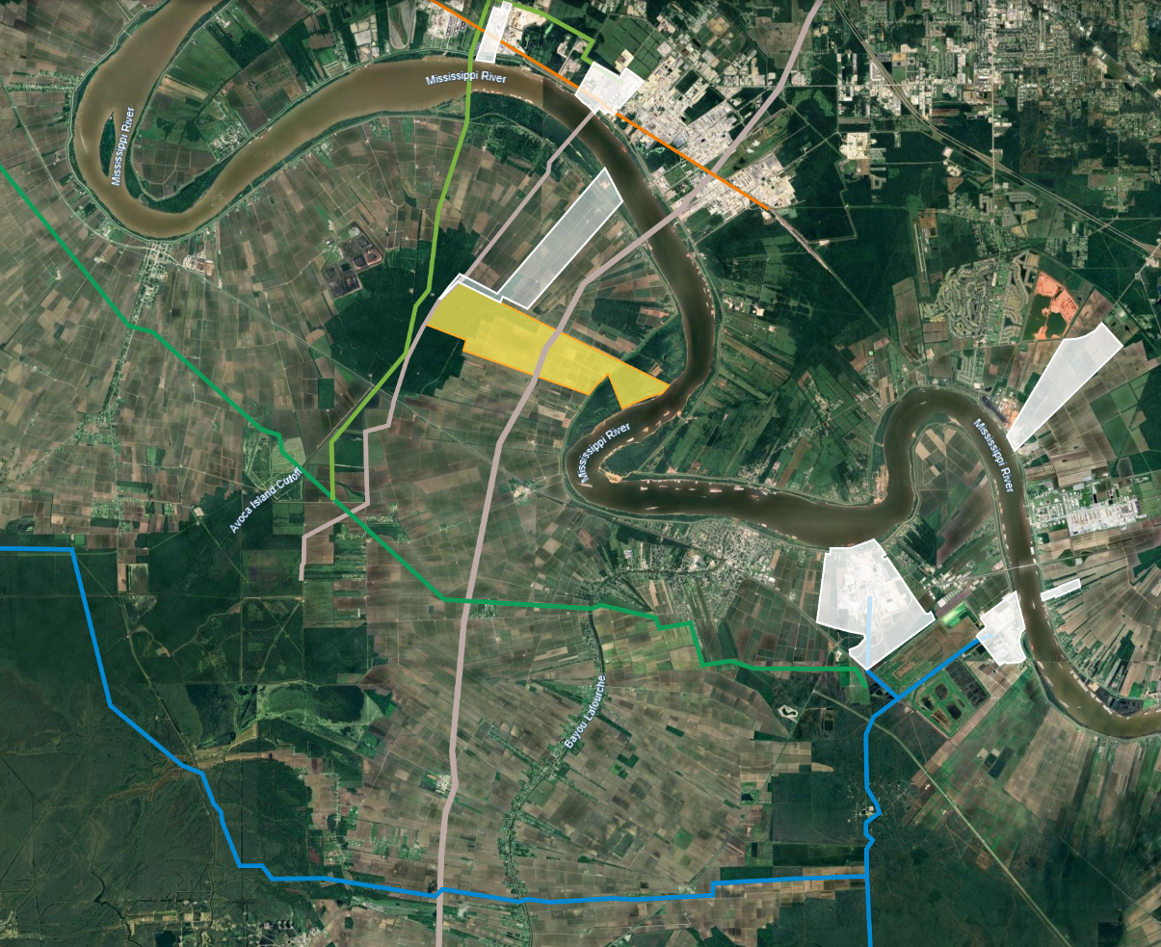





Advantage: Location
Strategically sited in the center of ammonia production
Plant | Size | Remarks
 | 0.5 MTPA 1.2 MTPA | Existing New Blue cancelled 2024
 | 1.4 MTPA | New Blue
 | 1.2 MTPA x 6 | New Blue
 | 3.3 MTPA | New Blue
 | 4.3 MTPA | Existing
 | N/A | Distribution warehouse
 | 0.45 MTPA | Existing
Gas pipelines
Ammonia pipelines
H₂ pipelines
CO₂ pipelines
Confidential

Slide 9


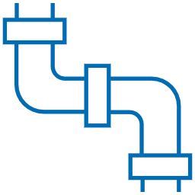
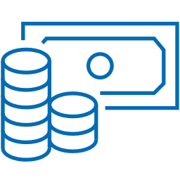
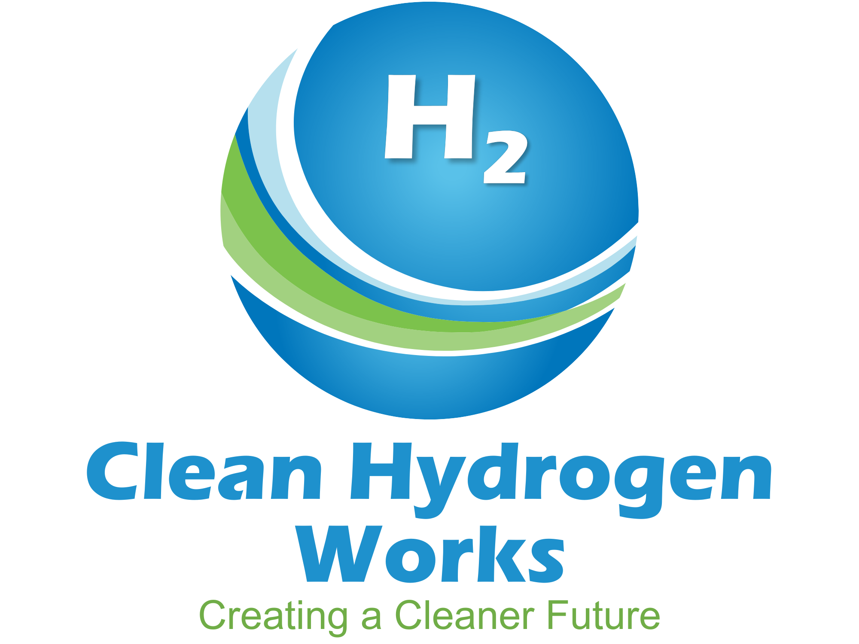
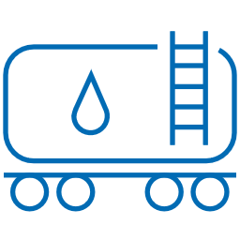



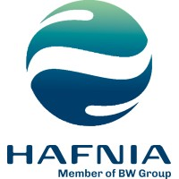




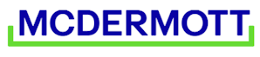
Experienced Shareholders & Partners
Best-in-class global leadership
CO₂ transport & sequestration
Ongoing
offtaker network
Financial advisor
Owns the largest liquid
CO₂ pipeline in USGC
We are currently holding conversations for early offtake
CHW is open to pairing offtake with project equity
CHW is flexible to various contract structures
Technology provider
Shipping and transport
  World’s largest shipping company by fleet size
  Reforming tech supplier for 1000+ projects
  World’s leading oil product tanker co.
Engineering and FEED
  Worked on >50% of the world’s carbon capture projects
Legal
  Strong and extensive experience in USGC and mega-module construction
Extensive experience with off-take and FID financing
Pre-NDA

Slide 10
Commitment to Project Delivery
2021
2022
2023
2024
2025-2026
2029
Site secured
Selected tech licensor & engineering consultant
Secured binding CCS contract
Completed CAPEX estimation
Round A financing
Sign offtake agreements
FEED
Secure project permits
Sign EPC contract
Secure project financing (FID)
Commercial operations date (COD)

Slide 11


Commitment To The Community
To develop a project of which both the community and company can be proud:
OUR GOAL
Safeguarding the environment, operating safely, reliably, and with the highest integrity
Transparent and open, two-way communication with our stakeholders
Working collaboratively to provide pathways for additional training and job opportunities for local residents
OUR
COMMITMENT

Slide 12
VEE GODLEY
Senior Vice President,
Project Development
vee.godley@cleanhydrogenworks.com
215 Railroad Ave., Donaldsonville, LA 70346
cleanhydrogenworks.com/ace

